Slide 1
Battery
is the primary "source" of electrical energy on vehicles. It stores chemicals, not electricity.
Two different types of lead in an acid mixture react to produce an electrical pressure.
This electrochemical reaction changes chemical energy to electrical energy.

Slide 2
Battery Functions
ENGINE OFF: Battery energy is used to operate the lighting and accessory systems.
ENGINE STARTING: Battery energy is used to operate the starter motor and to provide current for the ignition system during cranking.
ENGINE RUNNING: Battery energy may be needed when the vehicle's electrical load requirements exceed the supply from the charging system.
In addition, the battery also serves as a voltage stabilizer, or large filter, by absorbing abnormal, transient voltages in the vehicle's electrical system.
Without this protection, certain electrical or electronic components could be damaged by these high voltages.

Slide 3
Battery Types
According to cell
PRIMARY CELL: The chemical reaction totally destroys one of the metals after a period of time. Small batteries for flashlights and radios are primary cells.
SECONDARY CELLS: The metals and acid mixture change as the battery supplies voltage. The metals become similar, the acid strength weakens. This is called discharging. By applying current to the battery in the opposite direction, the battery materials can be restored. This is called charging. Automotive lead-acid batteries are secondary cells.

Slide 4
Battery Types
According to charged
WET-CHARGED: The lead-acid battery is filled with electrolyte and charged when it is built. During storage, a slow chemical reaction will cause self- discharge. Periodic charging is required. this is every 5 to 7 months.
DRY-CHARGED: The battery is built, charged, washed and dried, sealed, and shipped without electrolyte. It can be stored for 12 to .18 months. When put into use, it requires adding electrolyte and charging.

Slide 5
Battery Construction
An automobile battery contains a diluted sulfuric acid electrolyte and positive and negative electrodes, in the form of several plates.
Since the plates are made of lead or lead-derived materials, this type of battery is often called a lead acid battery.
A battery is separated into several cells (usually six in the case of automobile batteries), and in each cell there are several battery elements, all bathed in the electrolyte solution

Slide 6
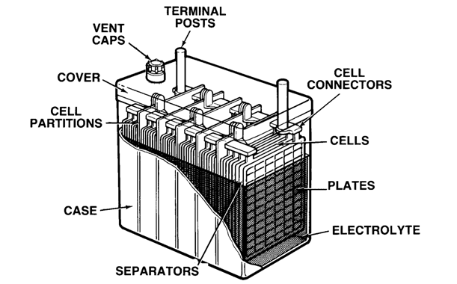
Battery Construction

Slide 7
Battery Construction………..
CASE: Container which holds and protects all battery components and electrolyte, separates cells, and provides space at the bottom for sediment (active materials washed off plates). Translucent plastic cases allow checking electrolyte level without removing vent caps.
COVER: Permanently sealed to the top of the case, provides outlets for terminal posts, vent holes for venting of gases and for battery maintenance (checking electrolyte, adding water).
PLATES: Positive and negative plates have a grid framework of antimony and lead alloy. Active material is pasted to the grid. brown-colored lead dioxide on positive plates, gray- colored sponge lead on negative plates. The number and size of the plates determine current capability. Batteries with large plates or many plates produce more current than batteries with small plates or few plates.

Slide 8
Battery Construction…….
CELL PARTITIONS: Part of the case, the partitions separate each cell.
TERMINAL POSTS: Positive and negative posts (terminals) on the case top have thick, heavy cables connected to them. These cables connect the battery to the vehicle's electrical system (positive) and to ground (negative).
VENT CAPS: Types include individual filler plugs, strip-type, or box-type. They allow controlled release of hydrogen gas during charging (vehicle operation). Removed, they permit checking electrolyte and, if necessary, adding water.
ELECTROLYTE: A mixture of sulfuric acid and water. It reacts chemically with the active materials in the plates to create an electrical pressure (voltage). And, it conducts the electrical current produced by that pressure from plate to plate. A fully charged battery will have about 36% acid and 64% water.

Slide 9
Battery Construction…….
SEPARATORS: Thin, porous insulators (woven glass or plastic envelopes) are placed between positive and negative plates. They allow passage of electrolyte, yet prevent the plates from touching and shorting out.
CELLS: An assembly of connected positive and negative plates with separators in between is called a cell or element. When immersed in electrolyte, a cell produces about 2.1 volts(regardless of the number or size of plates). Battery cells are connected in series, so the number of cells determines the battery voltage. A "1 2 - volt" battery has six cells.
CELL CONNECTORS: Heavy, cast alloy metal straps are welded to the negative terminal of one cell and the positive terminal of the adjoining cell until all six cells are connected in series.

Slide 10
CELL THEORY
A lead-acid cell works by a simple principle: when two different metals are immersed in an acid solution, a chemical reaction creates an electrical pressure.
One metal is brown-colored lead dioxide (Pb02). It has a positive electrical charge. The other metal is gray colored sponge lead (Pb). It has a negative electrical charge. The acid solution is a mixture of sulfuric acid (H2SO4) and water (H20). It is called electrolyte.
If a conductor and a load are connected between the two metals, current will flow. This discharging will continue until the metals become alike and the acid is used up. The action can be reversed by sending current into the cell in the opposite direction. This charging will continue until the cell materials are restored to their original condition.

Slide 11
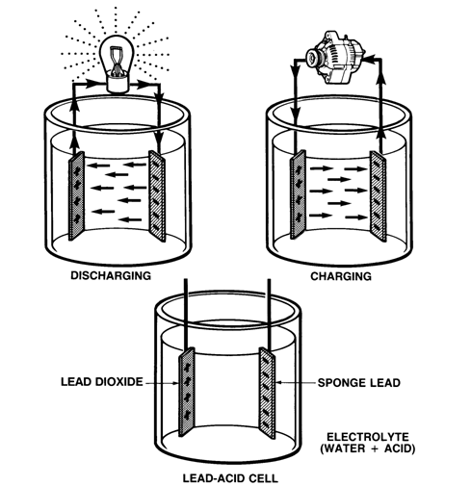
CELL THEORY……….

Slide 12
ELECTROCHEMICAL REACTION
A lead-acid storage battery can be partially discharged and recharged many times.
There are four stages in this discharging/charging cycle.
CHARGED
DISCHARGING
DISCHARGED
CHARGING

Slide 13
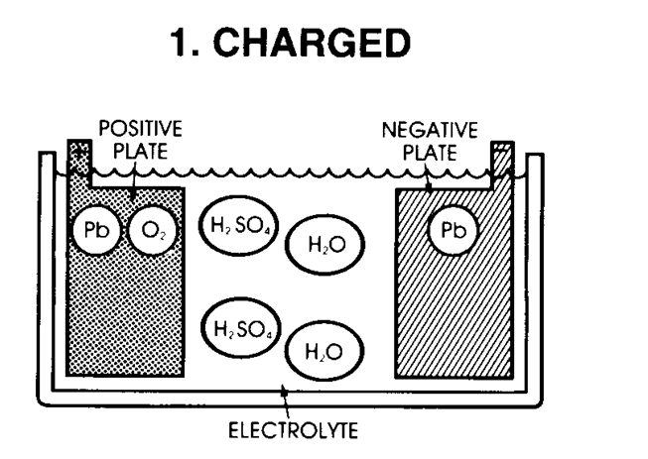
CHARGED
A fully charged battery contains a negative plate of sponge lead (Pb), a positive plate of lead dioxide (Pb02), and electrolyte of sulfuric acid (H2SO4) and water (H20).

Slide 14
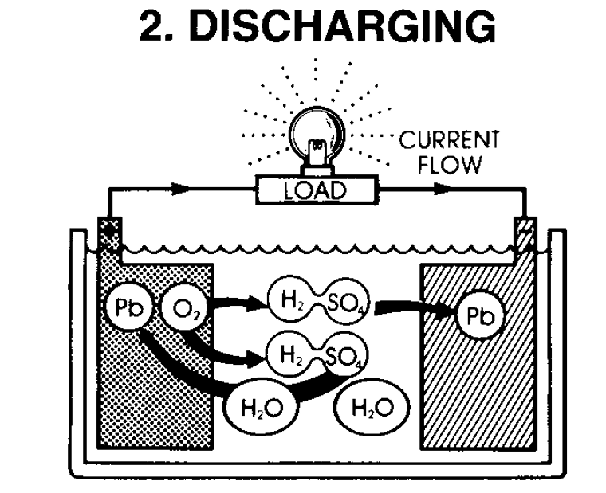
DISCHARGING
As the battery is discharging, the electrolyte becomes diluted and the plates become sulfated. The electrolyte divides into hydrogen (H2) and sulfate(S04) . The hydrogen (H2) combines with oxygen (0) from the positive plate to form more water (H20). The sulfate combines with the lead (Pb) in both plates to form lead sulfate (PbS04)

Slide 15
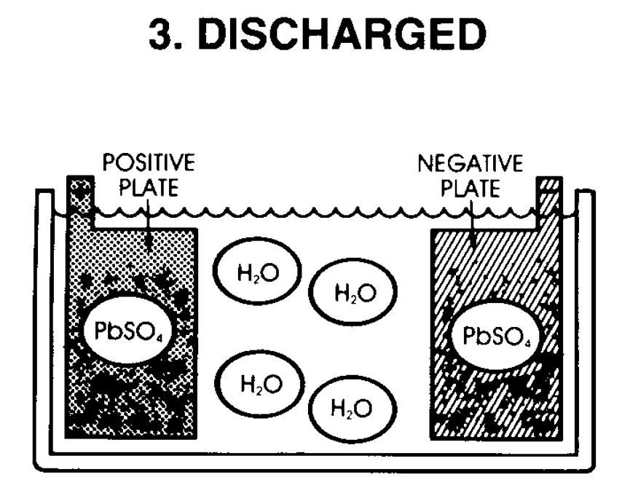
DISCHARGED
In a fully discharged battery, both plates are covered with lead sulfate (PbSO4) and the electrolyte is diluted to mostly water (H2O).

Slide 16
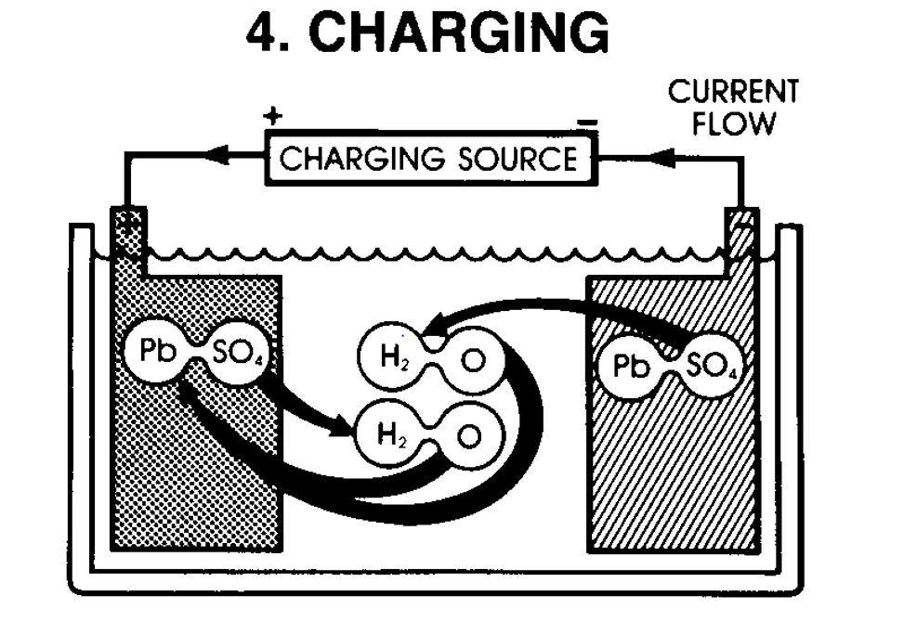
CHARGING
During charging, the chemical action is reversed. Sulfate (S04) leaves the plates and combines with hydrogen (H2) to become sulfuric acid (H2SO4). Free oxygen (02) combines with lead (Pb) on the positive plate to form lead dioxide (Pb02). Gassing occurs as the battery nears full charge, and hydrogen bubbles out at the negative plates, oxygen at the positive.

Slide 17
Capacity Ratings
The battery must be capable of cranking the engine and providing adequate reserve capacity. Its capacity is the amount of electrical energy the battery can deliver when fully charged.
Capacity is determined by the size and number of plates, the number of cells, and the strength and volume of electrolyte.
The most commonly used ratings are:
Cold Cranking Amperes (CCA)
Reserve Capacity (RC)
Amp-Hours (AH)
Power (Watts)

Slide 18
COLD-CRANKING AMPERES (CCA)
The battery's primary function is to provide energy to crank the engine during starting. This requires a large discharge in a short time.
The CCA Rating specifies, in amperes, the discharge load a fully charged battery at 0˚F (-1 7.8˚C) can deliver for 30 seconds while maintaining a voltage of at least 1.2 volts per cell (7.2 volts total for a 12-volt battery).
Batteries used on various vehicles have CCA ratings ranging from 350 to 560 amps.

Slide 19
RESERVE CAPACITY (RC)
The battery must provide emergency energy for ignition, lights, and accessories if the vehicle's charging system fails. This requires adequate capacity at normal temperatures for a certain amount of time.
The RC Rating specifies, in minutes, the length of time a fully charged battery at 80˚F (26.7'C) can be discharged at 25 amps while maintaining a voltage of at least 1.75 volts per cell (10.5 volts total for a 12-volt battery). Batteries used on various vehicles have RC ratings ranging from 55 to 115 minutes

Slide 20
AMP-HOURS (AH)
The battery must maintain active materials on its plates and adequate lasting power under light-load conditions. This method of rating batteries is also called the 20-hour discharge rating. Original equipment batteries are rated in amp-hours. The ratings of these batteries are listed in the parts microfiche.
The Amp-Hour Rating specifies, in amp hours, the current the battery can provide for 20 hours at 80˚F (26.7˚C) while maintaining a voltage of at least 1.75 volts per cell (10.5 volts total for a 12- volt battery).
For example, a battery that can deliver 4 amps for 20 hours is rated at 80 amp-hours (4 x 20 = 80). Batteries used on various vehicles have AH ratings ranging from 40 to 80 amp-hours.

Slide 21
POWER (WATTS)
The battery's available cranking power may also be measured in watts.
The Power Rating, in watts, is determined by multiplying the current available by the battery voltage at 0˚F (-1 7.8˚C).
Batteries used on various vehicles have power ratings ranging from 2000 to 4000 watts

Slide 22
FACTORS AFFECTING CHARGING
Five factors affect battery charging by increasing its internal resistance and CEMF (counter-electromotive force produced by the electrochemical reaction)
TEMPERATURE: As the temperature decreases the electrolyte resists charging. A cold battery will take more time to charge; a warm battery, less time. Never attempt to charge a frozen battery.
STATE-OF-CHARGE: The condition of the battery's active materials will affect charging. A battery that is severely discharged will have hard sulfate crystals on its plates. The vehicle's charging system may charge at too high of a rate to remove such sulfates.
PLATE AREA: Small plates are charged faster than large plates. When sulfation covers most of the plate area, the charging system may not be able to restore the battery.
IMPURITIES: Dirt and other impurities in the electrolyte increase charging difficulty.
GASSING: Hydrogen and oxygen bubbles form at the plates during charging. As these bubble out, they wash away active material, cause water loss, and increase charging difficulty.

Slide 23
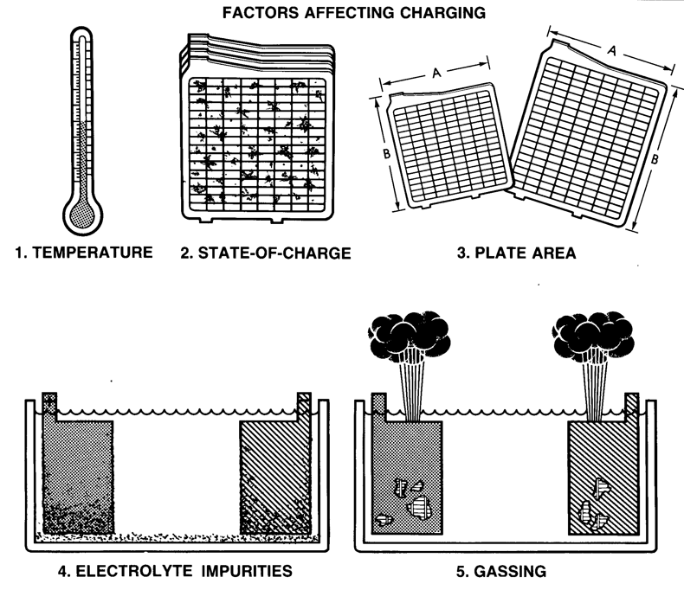
FACTORS AFFECTING CHARGING………

Slide 24
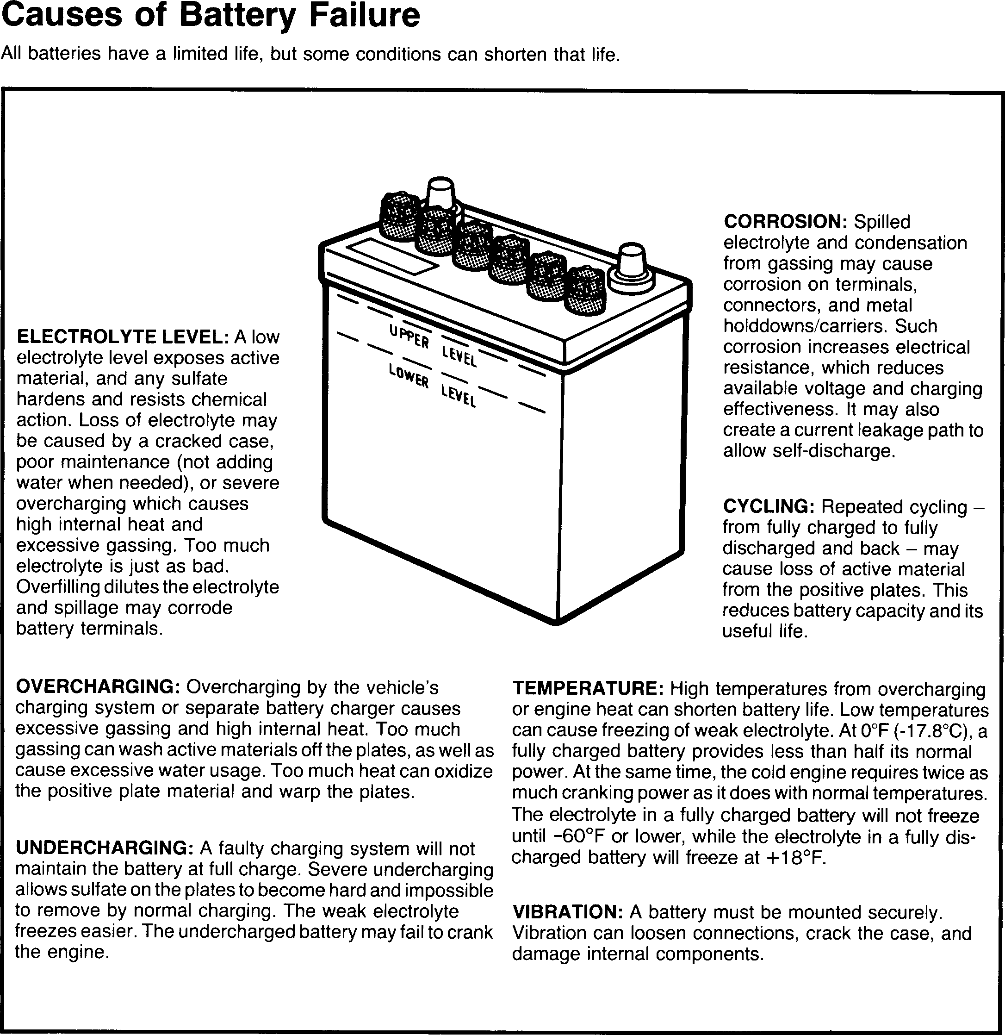

Slide 25
Diagnosis and Testing
All batteries require routine maintenance to identify and correct problems caused by physical abuse and low electrolyte levels.
A visual inspection can identify such physical problems.
A state-of-charge test checks the electrolyte strength. (Specific Gravity and Open Circuit Voltage)
Electrical testing (Capacity or Heavy Load Test) identifies overcharging or undercharging problems.

Slide 26
SAFETY FIRST!
When testing or servicing a battery, safety should be your first consideration.
The electrolyte contains sulfuric acid. It can eat your clothes. It can burn your skin. It can blind you if it gets in your eyes. It can also ruin a car's finish or upholstery.
If electrolyte is splashed on your skin or in your eyes, wash it away immediately with large amounts of water.
If electrolyte is spilled on the car, wash it away with a solution of baking soda and water.
When a battery is being charged, either by the charging system or by a separate charger, gassing will occur. Hydrogen gas is explosive. Any flame or spark can ignite it. If the flame travels into the cells, the battery may explode.

Slide 27
Safety precautions include:
Safety precautions include:
Wear gloves and safety glasses.
Remove rings, watches, other jewelry.
Never use spark-producing tools near a battery.
Never lay tools on the battery.
When removing cables, always remove the ground cable first.
When connecting cables, always connect the ground cable last.
Do not use the battery ground terminal when checking for ignition spark.
If you have to mix battery electrolyte, pour the acid into the water - not the water into the acid.
Always follow the recommended procedures for battery testing and charging and for jump starting an engine.

Slide 28
CARE OF ELECTRONICS
Disconnecting the battery will erase the memory on electronic devices. Write down trouble codes and programmed settings before disconnecting the battery.
Also, to prevent damage to electronic components:
Never disconnect the battery with the ignition ON.
Never use an electric welder without the battery cables disconnected.
Never reverse battery polarity.

Slide 29
VISUAL INSPECTION
Battery service should begin with a thorough visual inspection.
This may reveal simple, easily corrected problems, or problems that might require battery replacement.
Check for cracks in the battery case and for broken terminals. Either may allow electrolyte leakage. The battery must be replaced.
Check for cracked or broken cables or connections. Replace, as needed.
Check for corrosion on terminals and dirt or acid on the case top. Clean the terminals and case top with a mixture of water and baking soda or ammonia. A wire brush is needed for heavy corrosion on the terminals.
Check for a loose battery hold-down and loose cable connections. Tighten, as needed.

Slide 30
VISUAL INSPECTION……..
Check the level of electrolyte. The level can be viewed through the translucent plastic case or by removing the vent caps and looking directly into each cell. The proper level is 1/2" above the separators. If necessary, add distilled water to each low cell. Avoid overfilling. When water is added, always charge the battery to make sure the water and acid mix.
Check for cloudy or discolored electrolyte caused by overcharging or vibration. This could cause high self discharge. The problem should be corrected and the battery replaced.
Check the condition of plates and separators. Plates should alternate dark (+) and light (-). If all are light, severe undercharging is indicated. Cracked separators may allow shorts. The battery should be replaced. An undercharging problem

Slide 31
VISUAL INSPECTION……..
check the tension and condition of the alternator drive belt. A loose belt must be tightened. It will prevent proper charging. A belt too tight will reduce alternator life. It should be loosened to specs. A frayed or glazed belt will fail during operation. Replace it. NOTE: Approved Equipment tension gauge: Nippondenso, BTG-20 (SST) Borroughs BT-33-73F
Check for battery drain or parasitic loads using an ammeter. Connect the ammeter in series between the battery negative terminal and ground cable connector. Toyota vehicles typically show less than .020 amp of current to maintain electronic memories ... a reading of more than 035 amp is unacceptable. If the ammeter reads more than .035 amp, locate and correct the cause of excessive battery drain.
Check for battery discharge across the top of the battery using a voltmeter. Select the low voltage scale on the meter, connect the negative (black) test lead to the battery's negative post, and connect the positive (red) test lead to the top of the battery case. If the meter reading is more than 0.5 volt, clean the case top using a solution of baking soda and water.

Slide 32
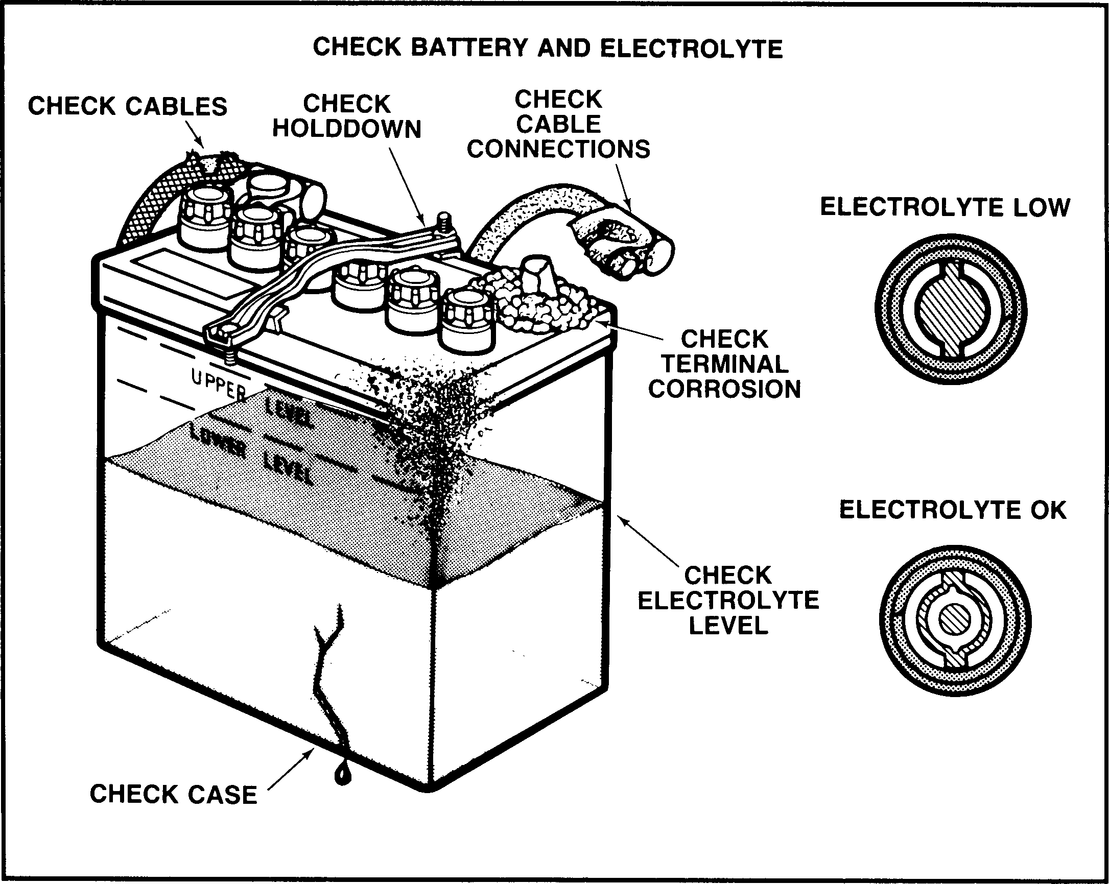
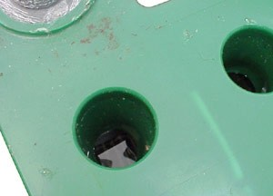
VISUAL INSPECTION……..

Slide 33
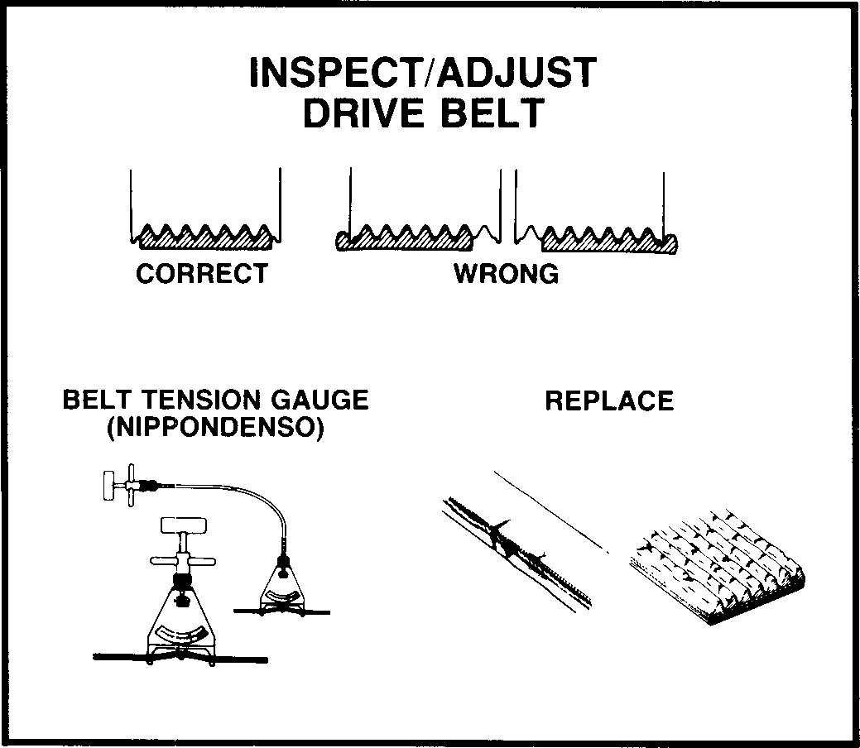
VISUAL INSPECTION……..

Slide 34
STATE-OF-CHARGE TEST
The state-of-charge test checks the battery's chemical condition. One method uses a hydrometer to measure the specific gravity of the electrolyte.
Another method uses a digital voltmeter to check the battery's open circuit voltage and, for a general indication of the battery's condition, check the indicator eye (if the battery has one) or check the headlamp brightness during starting.
Specific Gravity Specific gravity means exact weight. The hydrometer compares the exact weight of electrolyte with that of water. Strong electrolyte in a charged battery is heavier than weak electrolyte in a discharged battery.
By weight, the electrolyte in a fully charged battery is about 36% acid and 64% water. The specific gravity of water is 1.000. The acid specific gravity is 1.835. The electrolyte mixture of water and acid has a specific gravity of 1.270 is usually stated as "twelve and seventy.“
By measuring the specific gravity of the electrolyte, you can tell if the battery is fully charged, requires charging, or must be replaced. It can tell you if the battery is charged enough for the capacity, or heavy- load test.

Slide 35
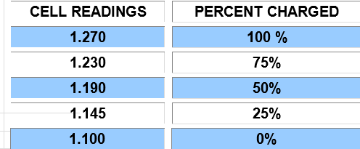
STATE-OF-CHARGE TEST
The battery must be at least 75% charged to perform a heavy load test. (The heavy load test will be discussed later). In other words, each cell must have a specific gravity of 1.230 or higher to proceed
If the battery is less than 75% charged, it must be fully recharged before proceeding. If the battery is 75% or higher proceed to a heavy load test. A battery not sufficiently charged will fail because it is discharged

Slide 36
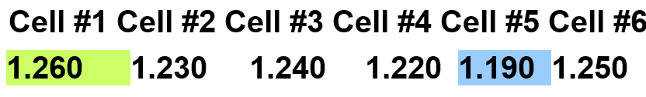
SPECIFIC GRAVITY - EXCESSIVE CELL VARIATION READINGS
Variation in specific gravity among cells cannot vary more than 0.050. The variance is the difference between the lowest cell and the highest cell.
A battery must be condemned for excessive cell variation if more that 0.050. In the example below, the highest SG reading is cell #1 (shown in green) while the lowest SG reading is cell #5 (shown in blue); the difference is 0.070 which requires battery replacement. Cell #5 if failing.
Many factors contribute to cell variation; for example, if water was just added to that cell, the cell is then diluted with water resulting is a lower specific gravity reading. Recharging the battery would correct this false reading.

Slide 37
SPECIFIC GRAVITY TEST PROCEDURE (HYDROMETER)
The following steps outline a typical procedure for performing a state-of-charge test:
Remove vent caps or covers from the battery cells.
Squeeze the hydrometer bulb and insert the pickup tube into the cell closest to the battery's positive (+) terminal.
Slowly release the bulb to draw in only enough electrolyte to cause the float to rise. Do not remove the tube from the cell.
Read the specific gravity indicated on the float. Be sure the float is drifting free, not in contact with the sides of top of the barrel. Bend down to read the hydrometer a eye level. Disregard the slight curvature of liquid on the float.
Record your readings and repeat the procedure for the remaining cells.

Slide 38
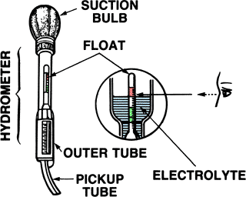
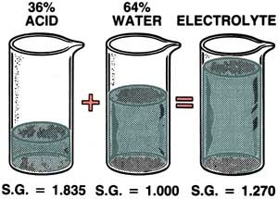
SPECIFIC GRAVITY TEST PROCEDURE (HYDROMETER)…..

Slide 39
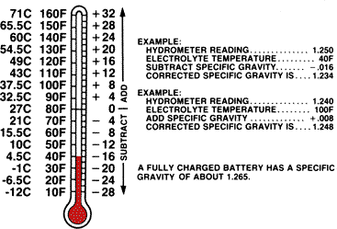
ADJUSTED SPECIFIC GRAVITY READINGS
Temperature correction is needed because specific gravity changes with temperature. Cold thickens the electrolyte and raises the specific gravity. Heat thins the electrolyte and lowers the specific gravity. Hydrometers are calibrated at 80'F (26.7'C). Electrolyte temperatures above or below 80'F must be adjusted. For every 10'F increment below 80'F, subtract 0.004 to the hydrometer readings, and for each 10'F increment above 80'F, add 0.004 to the readings. See the examples below.

Slide 40
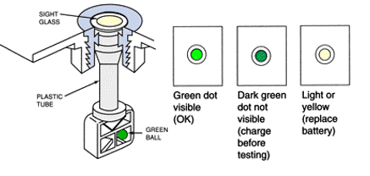
SPECIFIC GRAVITY TEST PROCEDURE (AC Delco Battery with built- in Hydrometer)
Wear suitable eye protection.
Observe the built-in hydrometer.
Green Dot is visible: the battery is sufficiently charged for further testing (Heavy Load Test).
Dark Green Dot is visible: the battery needs to be recharged before further testing.
Light or Yellow Dot is visible: replace the battery

Slide 41
OPEN CIRCUIT VOLTAGE
A digital voltmeter must be used to check the battery's open-circuit voltage. Analog meters are not accurate and cannot be used.
Turn on the headlamps' high beam for several minutes to remove any surface charge.
Turn headlamps off, and connect the digital voltmeter across the battery terminals.
Read the voltmeter. A fully charged battery will have an open-circuit voltage of 12.6 volts. On the other hand, a totally dead battery will have an open-circuit voltage of less than 12.0 volts.
Note: If the battery is 12.4v or higher, proceed to heavy load test. If the battery is less than 12.4v, the battery must be fully recharged before testing. Be sure to remove the surface charge completely; this is the number one mistake technicians make. If need be, place a load tester on the battery and load the battery for 10 seconds at approximately 200 amps. Allow a few minutes for the battery to recover then measure the open circuit voltage. This should remove the surface charge and allow an accurate open circuit voltage measurement. (Remember: a reading of 12.4 volts or higher load test the battery, 12.3 volts or less, recharge the battery.)

Slide 42
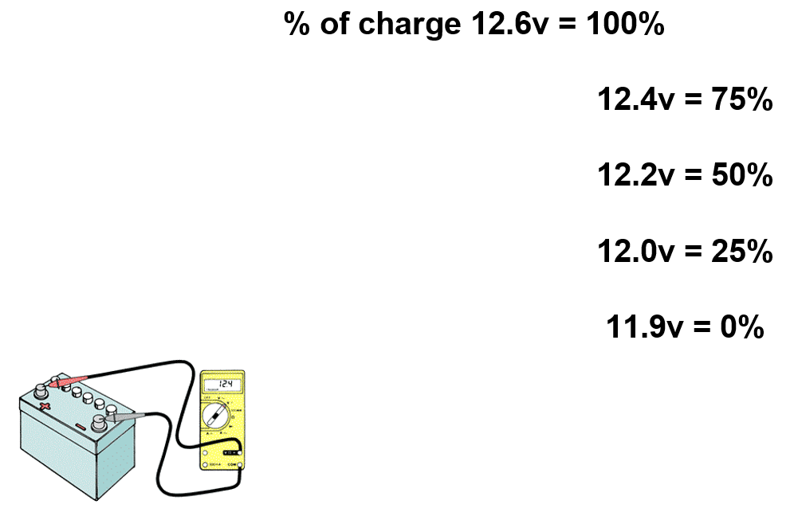
OPEN CIRCUIT VOLTAGE…….

Slide 43
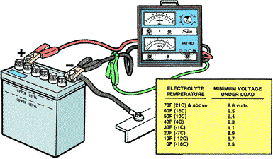
HEAVY LOAD TEST
While a State of Charge test determines the battery's state of charge, it does not measure the battery's ability to deliver adequate cranking power.
A capacity, or heavy-load test measures the battery's ability to deliver current. A battery load tester such as a Sun VAT-40 is used. (Note: the battery must be at least 75% charged before a heavy test can be performed.)

Slide 44
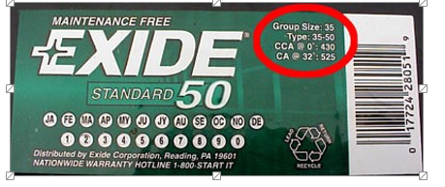
DETERMINE CAPACITY RATING
The capacity rating is located on the battery label. Ratings can be expressed in CCA (Cold Cranking Amps), AH (Amp-Hour), or JIS (Japanese Industrial Standard.) JIS uses a six digit code (not shown). A conversion table is offered below that can be printed. If no rating is found on the battery, then use the OEM battery rating found in most repair manuals.

Slide 45
HEAVY LOAD TEST PROCEDURE
Install the load tester as shown in an earlier slide.
Load the battery by turning the Load Increase control until the ammeter reads 3 times the amp-hour (AH) rating or one-half the cold-cranking ampere (CCA) rating.
Maintain the load for no more than 15 seconds, and note the voltmeter reading.
If the voltmeter reading during the test is 9.6 volts or higher, the battery is good. And 9.5 volts or below, the battery is defective and needs replacement.

Slide 46
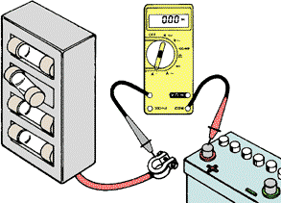
CURRENT DRAINS
Parasitic drains are the small current drains required to operate various electrical systems, such as the clock, computer memory, or alarms, that continue to work when the car is parked and the ignition is off. All vehicles today have parasitic drains and over time will drain all batteries if not driven or charged periodically. The problem is when the parasitic drain becomes excessive, usually over 35 milliamps.
Unwanted battery drain can also be the reason why a battery keeps discharging. Unwanted battery drain can be a result of excessive parasitic drain, or if the top of the battery is wet or has excessive corrosion, it could create a path between the two battery posts, causing a current drain; usually 0.5 volt potential or higher will result in a battery discharge. This is called Case Drain.

Slide 47
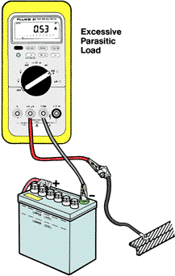
PARASITIC DRAIN
Check for excessive battery drain or parasitic loads using an ammeter.
Make sure all electrical loads are off in the car, doors closed, and the key is out of the ignition switch .
Disconnect one of the battery cables from the battery, placing an ammeter in series between the battery post and cable clamp.
The current draw reading should be less than 35 milliamps. A reading higher than this (or manufacturer specifications) would indicate excessive battery drain. Something is "on", allowing current to flow running down the battery.
Vehicles today typically will draw less than .020 amps (20 milliamps) of current to maintain electronic memories and circuits.

Slide 48
BATTERY SERVICE
Battery services are routinely performed. These services include:
Testing
Charging
Cleaning
Jumping a dead battery
Adding water.

Slide 49
BATTERY CHARGING
All battery chargers operate on the same principle: an electric current is applied to the battery to reverse the chemical action in the cells. Never connect or disconnect leads with the charger turned ON.
Follow the battery charger manufacturer's instructions. DO NOT attempt to charge a battery with frozen electrolyte.
When using a battery charger, always disconnect the battery ground cable first. This will minimize the possibility of damage to the alternator or electronic components in the vehicle.
The battery can be considered fully charged when all cells are gassing freely and when there is no change in specific gravity readings for more than one hour.
A slow charge is 5 or 10 amps while a fast charge is generally 15 amps or higher. A slow charge is always preferred.

Slide 50
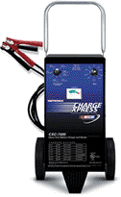

BATTERY CHARGER TYPES
Battery chargers are available in two classifications:
Automatic chargers (typically the type consumers purchase) pulse and cycle the charge current and voltage rates. This automatic cycling rate protects the battery from damage and allows the charge rate to taper over time.
Manual chargers (shown below), also known as wheel chargers, are preferred by automotive professionals. These charges do not cycle, but rather provide a constant non tapering charge. The constant charge rate allows the technician to accurately calculate the charge time to prevent overcharging of the battery.

Slide 51
GENERAL RULES FOR CHARGING A BATTERY
Always leave the vent caps in place during charging.
Always follow the battery charger manufacturer's instructions.
Always charge batteries in a well ventilated area, and wear eye protection and protective clothing, such as a rubber apron and rubber gloves.
Always keep sparks or flames away from the battery. (Do not smoke near a battery)
Recharge the battery at the same rate at which it was discharged. If the discharge was slow, then charge at a slow rate; if the discharge was rapid, then charge at a higher rate. (When in doubt always use a slow charge.)
Never charge a battery that is connected to a vehicle. Disconnect the battery and charge. Excessive voltage can damage electrical circuits on the vehicle.
Recheck specific gravity readings periodically, determine if further charging is still required.
Periodically check the battery for excessive heat by placing your hand on the side of the battery. If it is hot (125'F) to the touch, interrupt the charging (turn off) until the battery cools and lower charge rate.

Slide 52
CHARGING PROCEDURE - AUTOMATIC CHARGER
Determine the type of battery... "sealed" or "accessible". If "sealed," the battery must be charged using a slow rate. (A "sealed" battery does not allow access to the cells or the addition of water or measuring specific gravity.) If "accessible," the battery may be charged at either the slow or fast rates.
Insure the charger is disconnected from the power source and/or the charger is turned off.
Connect the charger to the battery: positive cable to the positive terminal or negative cable to the negative terminal. (Insure a good connection by rocking back and forth.)
Plug in the charger. If there is a setting switch for "regular" or "deep cycle" batteries, use regular setting for regular (accessible) batteries and sealed/gel electrolyte batteries. Use deep cycle setting for standard deep cycle batteries and maintenance free batteries. Always refer to battery charger instruction manual before using battery charger.
Periodically check the battery for excessive heat by placing your hand on the side of the battery. If it is hot (125'F) to the touch, interrupt the charging (turn off) until the battery cools.
During the charge cycle, the charger senses the battery's state of charge and will input amps at the appropriate rate. As the battery approaches a full state of charge, the input amperage will decrease.
After charging is complete, verify the charger is turned off and disconnected from the power source before removing charger cables.

Slide 53
CHARGING PROCEDURE - MANUAL CHARGER
Determine the type of battery... "sealed" or "accessible". If "sealed," the battery must be charged using a slow rate. (A "sealed" battery does not allow access to the cells for the addition of water or measuring specific gravity.) If "accessible," the battery may be charged at either the slow or fast rates.
Insure the charger is disconnected from the power source and/or the charger is turned off.
Connect the charger to the battery: positive cable to the positive terminal or negative cable to the negative terminal. (Insure a good connection by rocking clamp back and forth.)
Plug-in the charger, set -the charge rate, and turn on the charger.
Periodically check the battery for excessive heat by placing your hand on the side of the battery. If it is hot 125'F) to the touch, interrupt the charging (turn off) until the battery cools.
After charging is complete, insure charger is turned off and disconnected from the power source before removing charger cables.

Slide 54
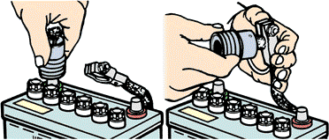
BATTERY TERMINAL CLEANING
Over a period of time, sulfuric acid will corrode battery terminals, clamps, and hold-down.
This corrosion adds resistance and lowers current flow to and from the battery. Corrosion can be easily cleaned with a mild solution of baking soda and water.
Battery terminals and cables are routinely removed, cleaned, and reinstalled. A battery brush, which has both an external and internal brushes, is ideal for cleaning the terminal posts and the inside of clamp.

Slide 55
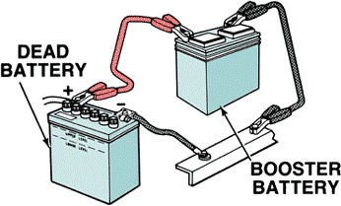
BATTERY JUMPING with Booster Cables
Jump starting a dead battery with a booster battery or battery in a car can be dangerous, so the proper sequence of connections will prevent sparks.
First, connect the two positive terminals, one from the good battery and the other to the dead battery.
Next connect one end of the jumper cable to the negative terminal of the booster (Good) battery.
Finally connect the other end to a good ground on the engine away from the dead battery. If a spark occurs, it won't be near the battery, thus reducing the chance for explosion. If the jump starting from another vehicle, start the vehicle, running the engine at 1500 RPM for a few minutes. While the engine is running, start the dead vehicle. Never jump start a frozen battery.

Slide 56
ADDING WATER
Under the rare occurrence of adding water to a battery, use only Distilled water. Minerals and chemicals that are commonly found in regular drinking water will react with the plate material and shorten battery life.
Under normal conditions the addition of water should not be required. However, the addition of water may be necessary when the battery has been overcharged, for overcharging results in excessive evaporation of water from the electrolyte.
The water level should be no higher than 1/8 inch below the bottom of the vent well.
To avoid permanent damage, make sure the electrolyte level never drops below the top of the plates.
Also, avoid over filling, this may result in electrolyte overflow from the battery.

Slide 57
Thanks

